Slide 1
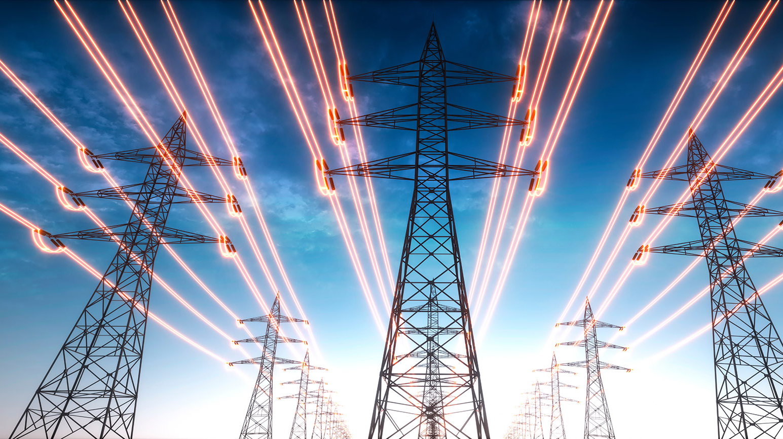
Electricity Billing System
.
Suraj Shelar

Slide 2

INTRODUCTION
Electricity Billing System is a Desktop-based application.
This project aims at serving the department of electricity by computerizing the billing system.
It mainly focuses on the calculation of units consumed during the specified time and the money to be charged by the electricity offices.
This computerized system will make the overall billing system easy, accessible, comfortable, and effective for consumers.
The main aim of our project is to satisfy customer by saving their time by payment process, maintaining records, and allowing the customer to view his/her records and permitting them to update their details
Suraj Shelar
Suraj Shelar

Slide 3
Objective Of The Project
To keep the information of consuming unit energy of current month.
To keep the information of Customer.
To keep the information of consuming unit energy of previous month.
To calculate the units consumed every month regularly.
To generate the bills adding penalty and rent.
To save the time by implementing payment process online.
Suraj Shelar
Suraj Shelar

Slide 4
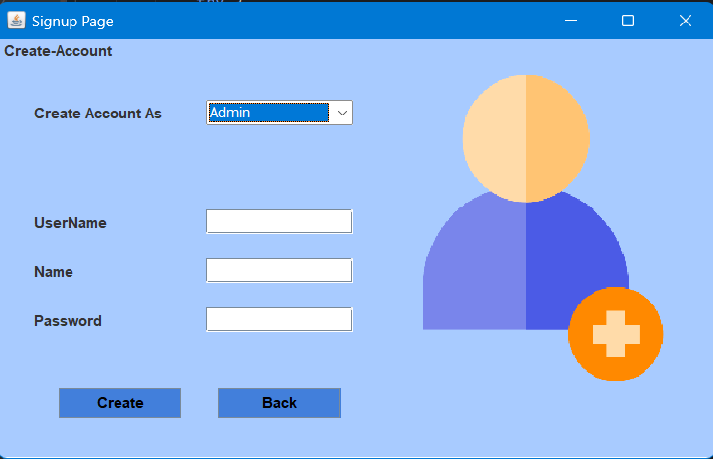
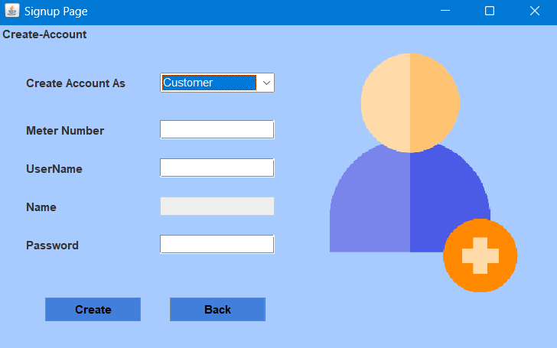
Sign Up
Admin
Here New customers/Admin will signup to access their accounts.
Customers User have to enter meter-no, username, name, password.
Admin User have to enter username, name, password
Customer
Suraj Shelar

Slide 5
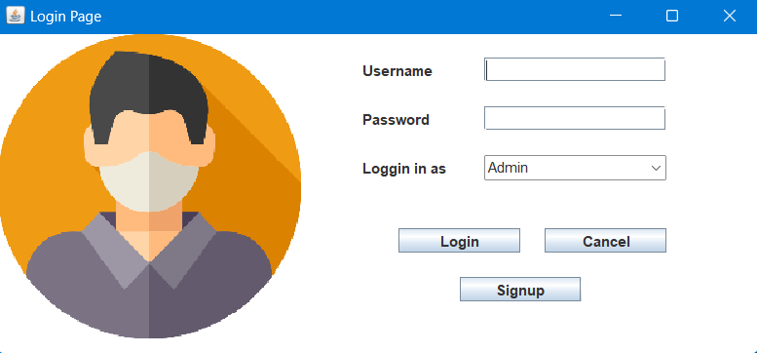
Login
Here Customer and Admin can login to their respective accounts.
The dropdown menu allows to choose whether to login as an admin or as a customer.
Suraj Shelar

Slide 6
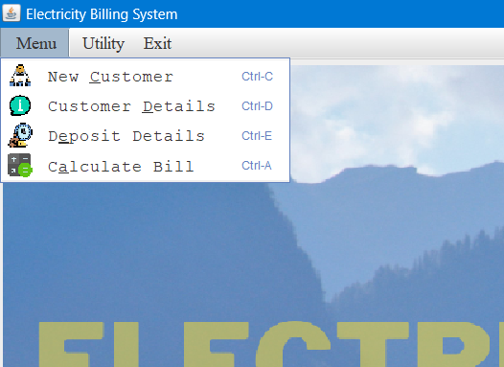
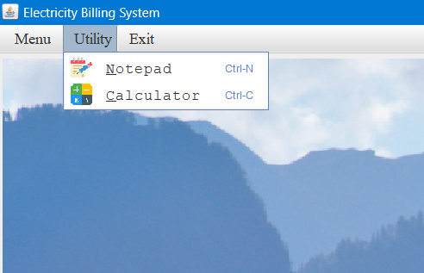
Admin
Admin’s Home Screen:
Admin lands on this page after successful login
This Screen Contains various fields like in menu section New Customer, Customer Details, Deposit Details, Calculate Bill.
In Utility section we have Notepad, Calculator
Exit is for Logout.
Suraj Shelar

Slide 7
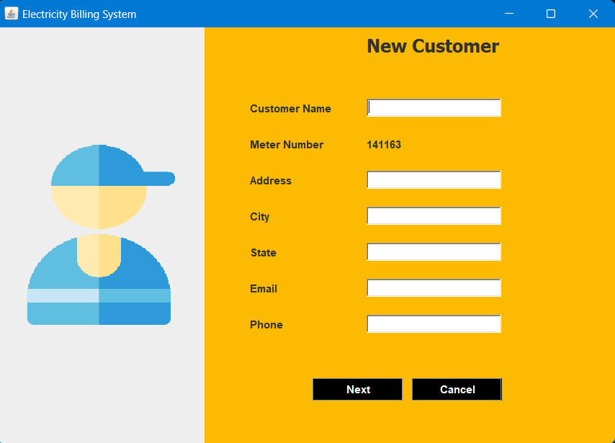
New Customer
This program will allow the admin to enter the customer details and automatically generates unique meter number.
If customer name, address, city, state, email and phone number is entered, insert the values into customer else print error
Suraj Shelar

Slide 8
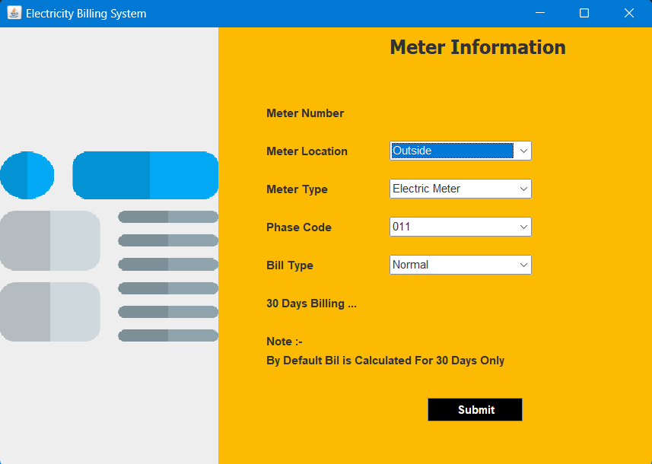
Meter Information
Here Admin selects the location and type of meter installed at the customers end.
Admin also selects the phase code and Bill type i.e. Residential or Commercial/Industrial
Suraj Shelar

Slide 9
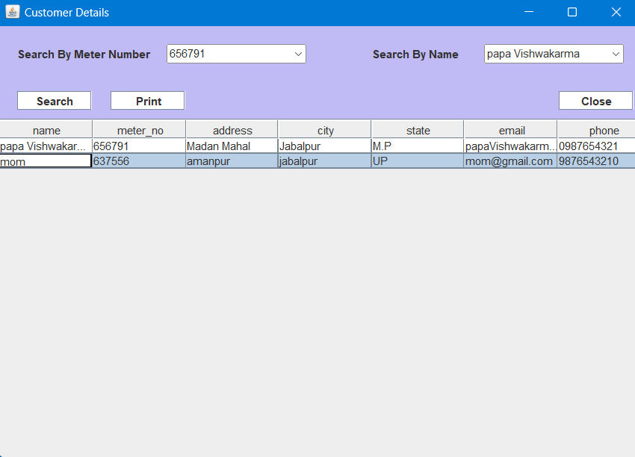
Customer Details
This program will allow the admin to view customer details.
If we need to print the details that has been viewed click onto print option
Suraj Shelar

Slide 10
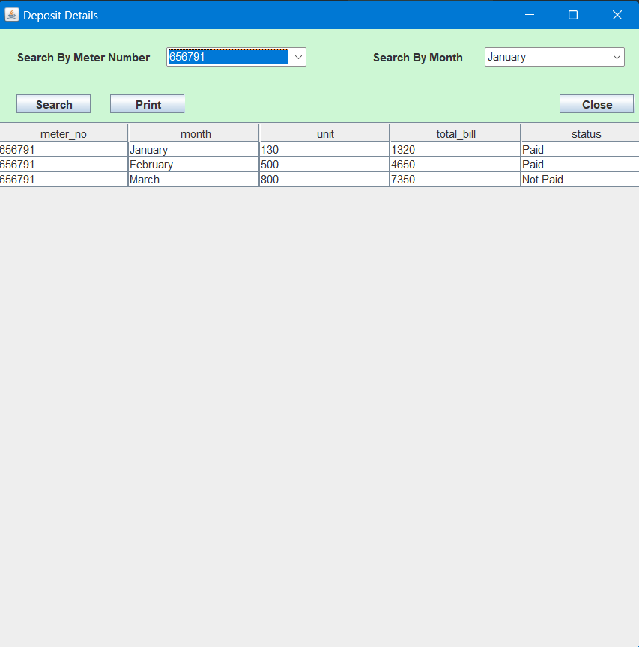
Deposit Details:-
This program will allow the admin to view bill details. If we need to sort the details based on meter_no and month.
If we need to search the particulars that has been viewed click onto search option.
If we need to print the particulars that has been viewed click onto print option.
Suraj Shelar

Slide 11
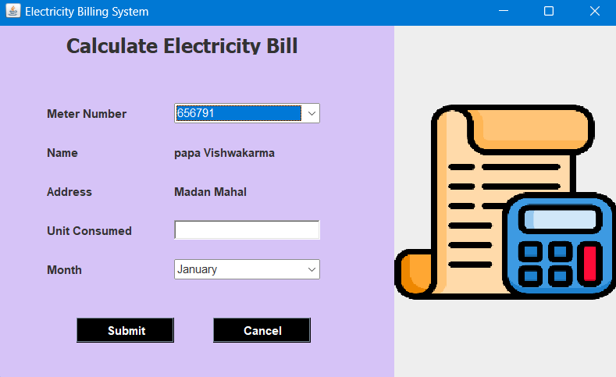


Calculate Bill
This program will allow the admin to calculate total bill when units consumed are inserted where meter-no and month is selected.
Submit the details of tax that has been entered by clicking onto submit button.
If we need to cancel the details that has been entered click onto cancel option.
Suraj Shelar

Slide 12
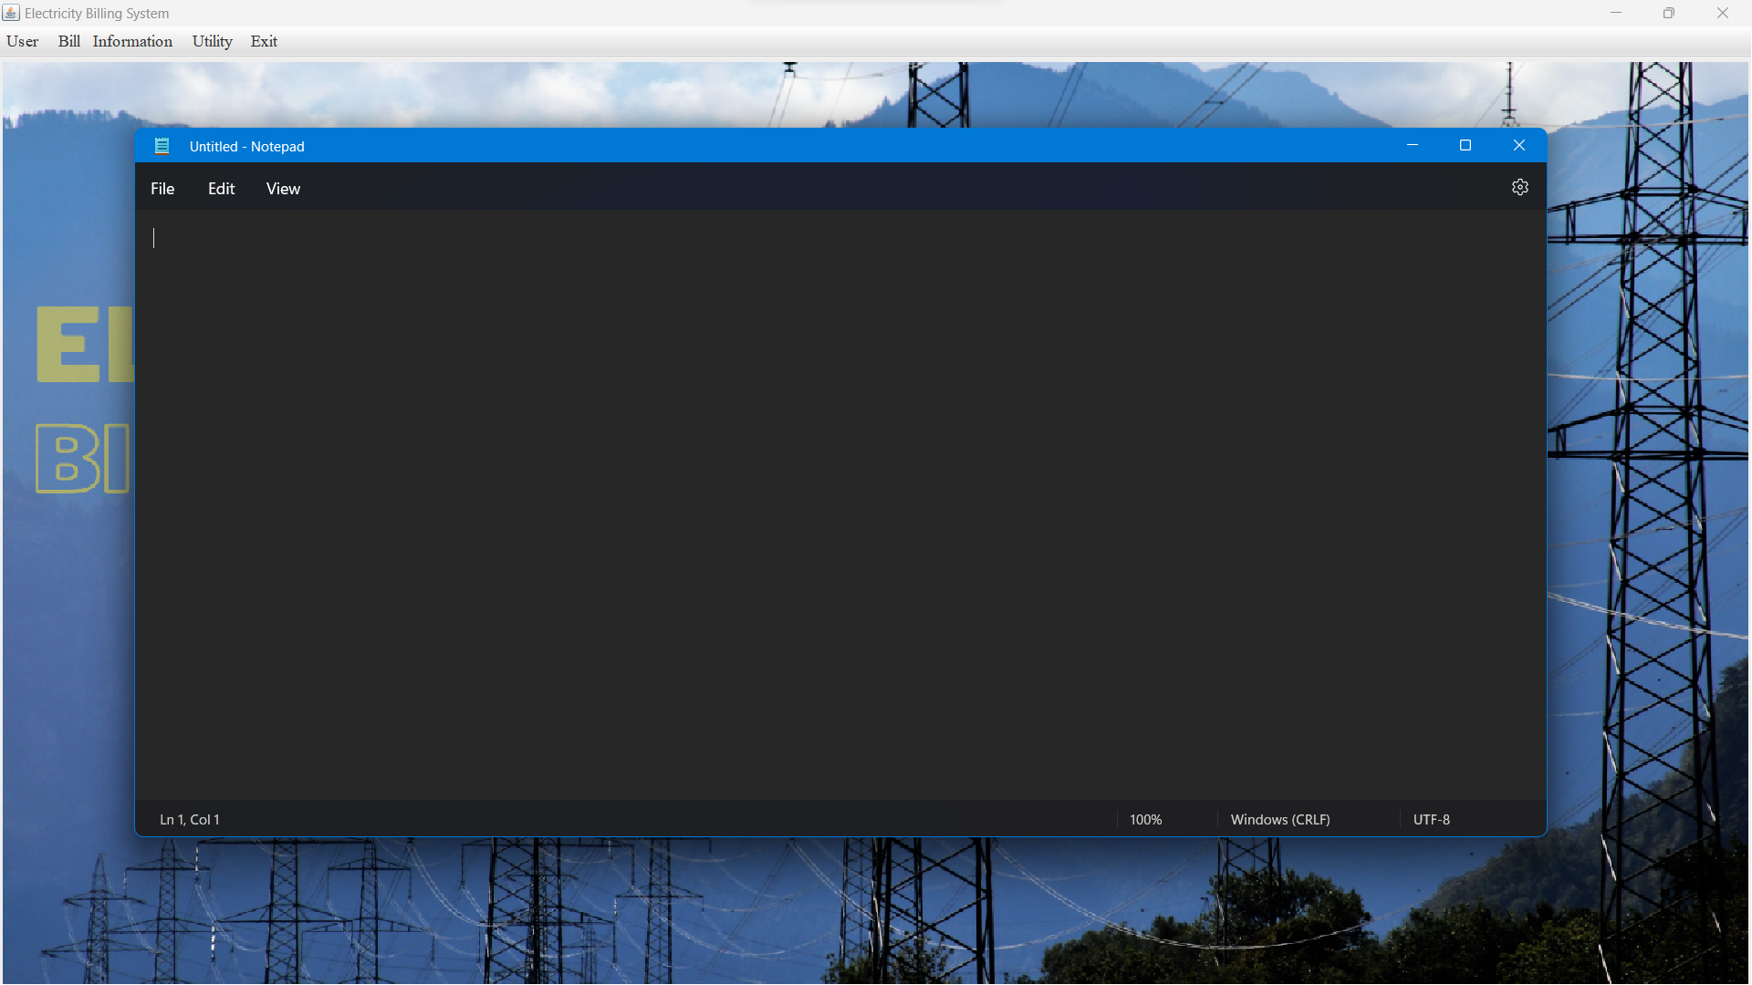
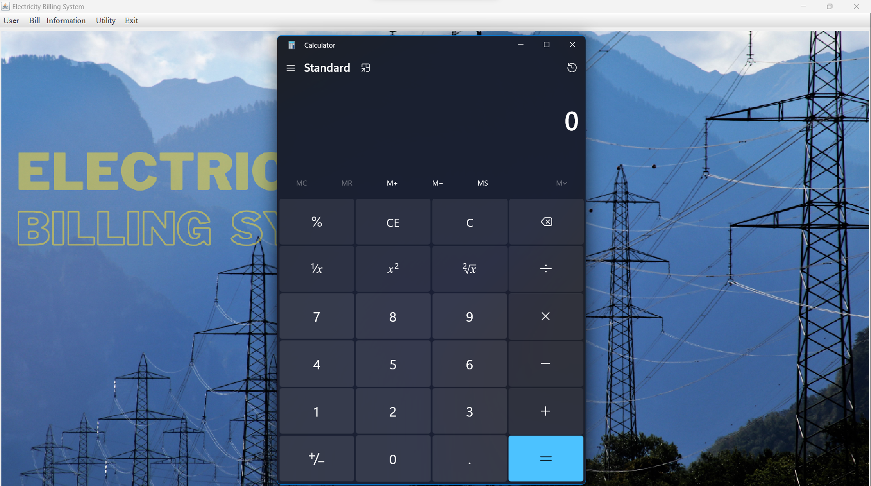
Notepad
When user clicks on notepad option under utilities section, its launches the notepad.
Calculator
When user clicks on calculator option under utilities section, its launches the calculator.
(This both feature is available to both Admins and Customers)
Suraj Shelar

Slide 13
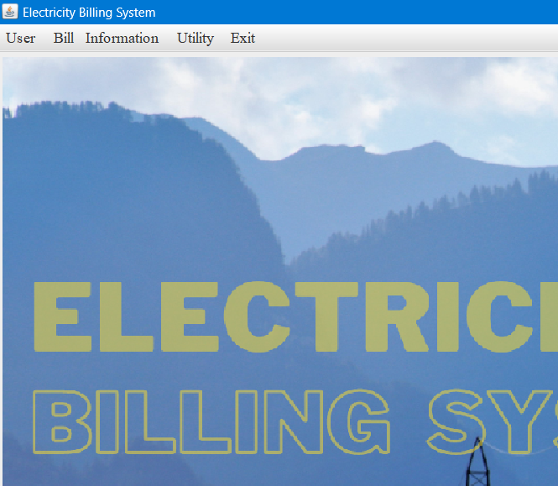
Customer
Customer lands on this page after successful login
This Screen Contains various fields like in user section Pay Bill, Bill Details
In Bill section we have Generate Bill Slip.
In Information section we have Update Information, View Information.
In Utility section we have Notepad, Calculator
Exit is for Logout.

Slide 14
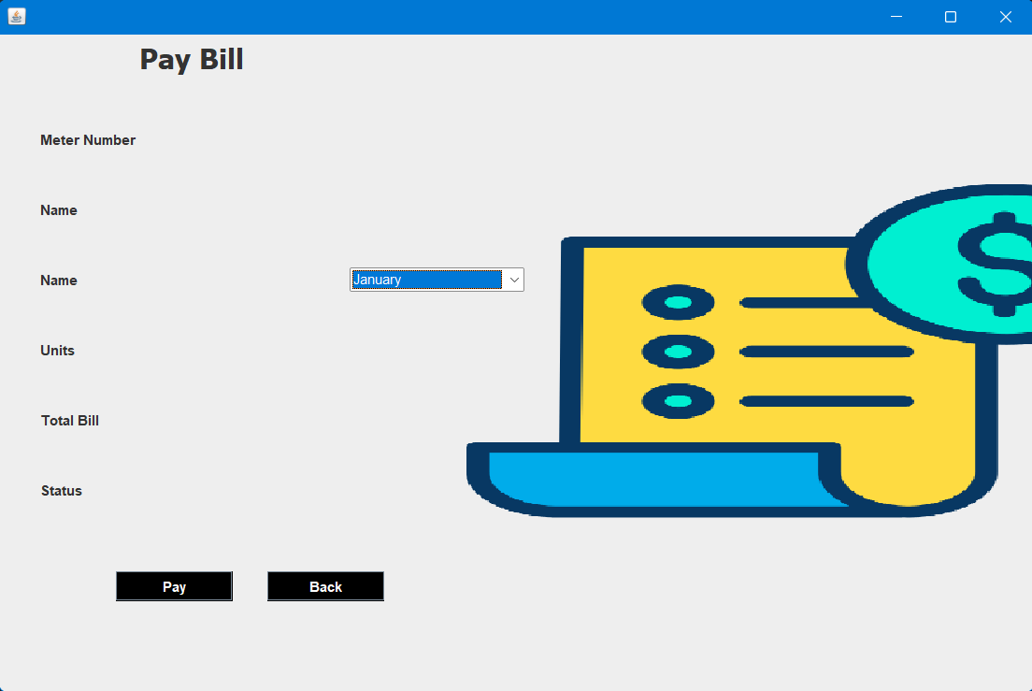
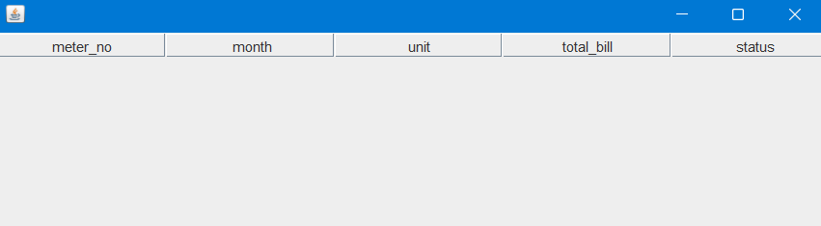
Pay Bill
Here customers pay their bills by selecting appropriate month.
Pay Bill
Bill Details
Here every customer can check the status of their bills, whether they have paid the bills or not.
Bill Details
Suraj Shelar
Suraj Shelar

Slide 15
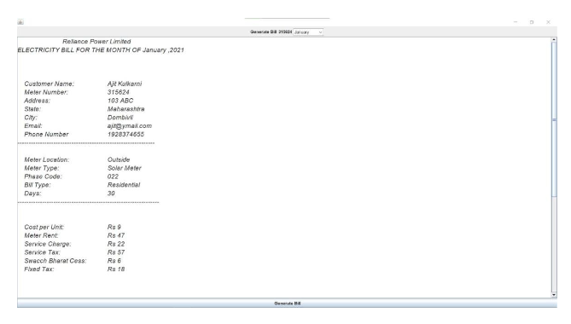
Generate Bill Slip.
Here customer can generate / see their bill in a proper breakdown of entire amount.
Suraj Shelar

Slide 16
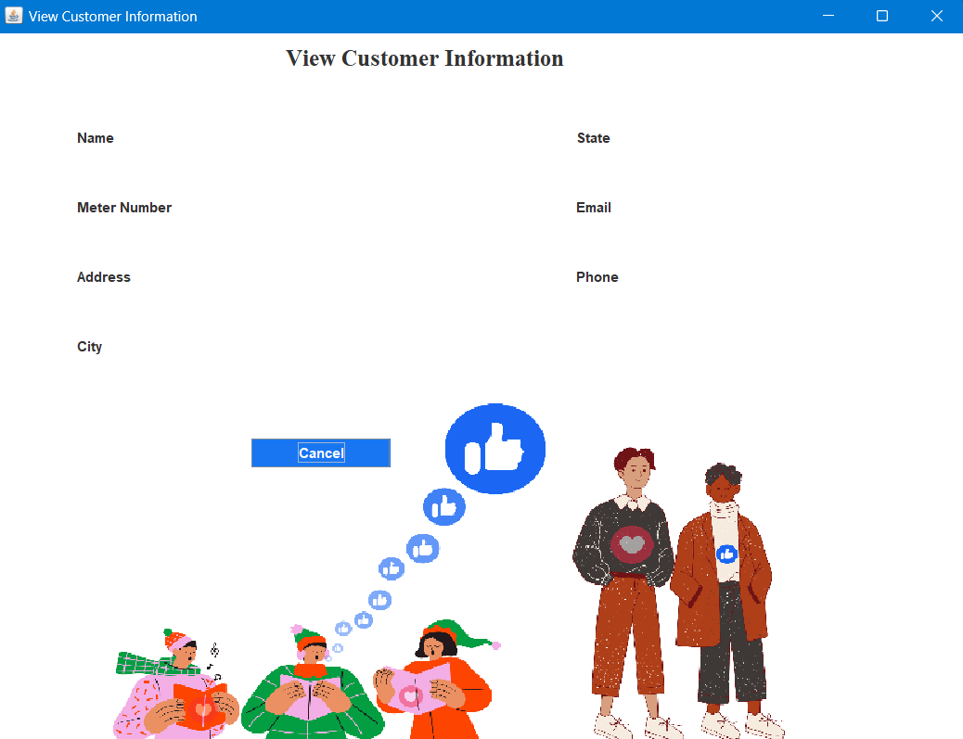
View Information
Here customer can see their entered information such as their name, meter number, address, city , state, email id and phone number.
Suraj Shelar

Slide 17
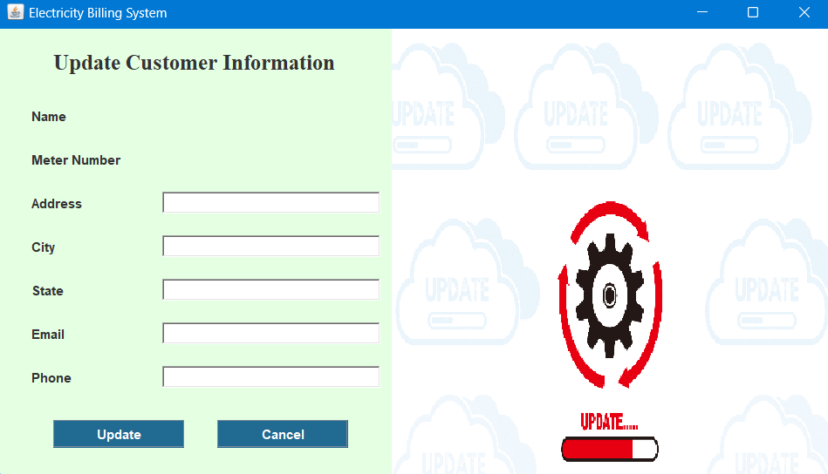
Update Information
Here customer can update their entered information if any correction is needed such as their address, city, state, email id and phone number.
Suraj Shelar

Slide 18
CONCLUSION
It is a software which helps the user to work with the billing cycles,
paying bills, managing different DETAILS under which are working etc.
This software reduces the amount of manual data entry and gives
greater efficiency. The User Interface of it is very friendly and can be easily
used by anyone.
It also decreases the amount of time taken to write details and other modules.
Suraj Shelar

